Slide 1
GRADE XII
SOLID STATE
SOLID STATE

Slide 2
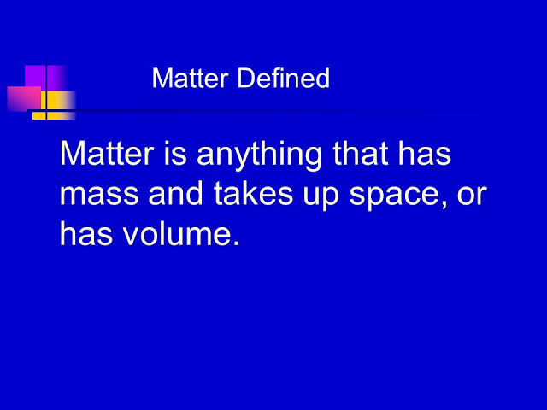

Slide 3
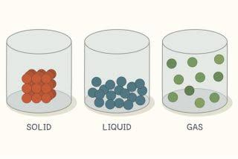

Slide 4
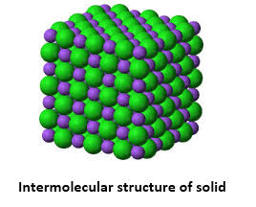

Slide 5
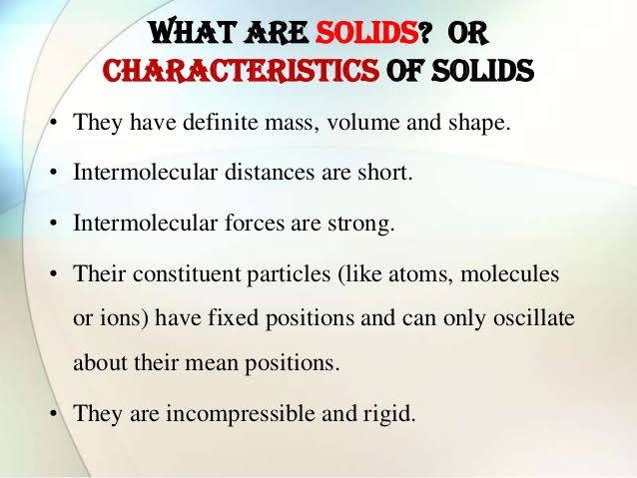

Slide 6
CRYSTALLINE SUBSTANCES | AMORPHOUS SUBSTANCES
Definite characteristic geometrical shape. Melt at a sharp and characteristic temperature. When cut with a sharp edged tool, they split into two pieces and the newly generated surfaces are plain and smooth. They have a definite and characteristic enthalpy of fusion. Anisotropic in nature. True solids. Long range order. | Irregular shape. Gradually soften over a range of temperature. When cut with a sharp edged tool, they cut into two pieces with irregular surfaces. They do not have definite enthalpy of fusion. Isotropic nature. Pseudo solids or super cooled liquids. Only short range order.

Slide 7
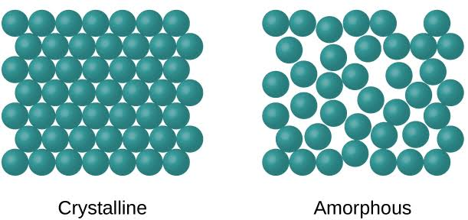

Slide 8
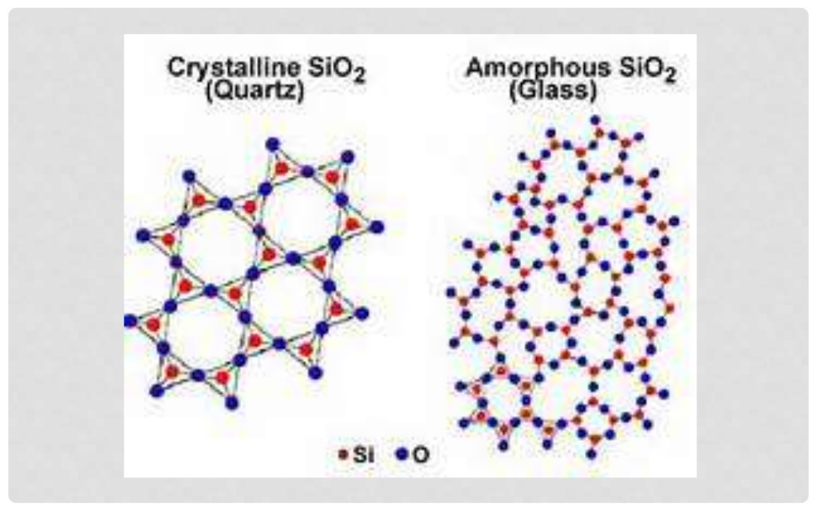

Slide 9
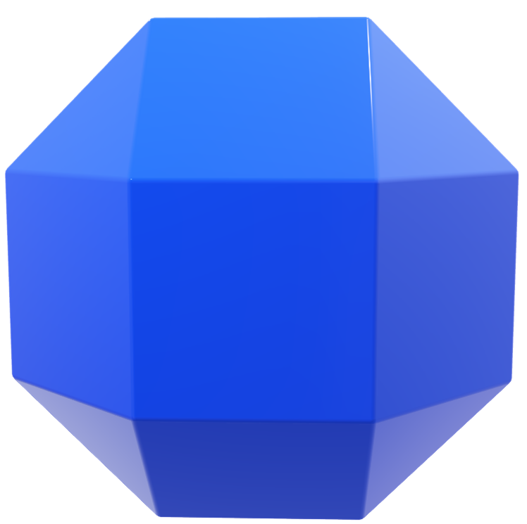
Isotropic and anisotropic nature:
Certain properties of solids like refractive index, when measured from different directions will result in different values for crystalline solids. This is called Anisotropic nature of crystals. Amorphous substances do not show this property and hence they are isotropic.

Slide 10
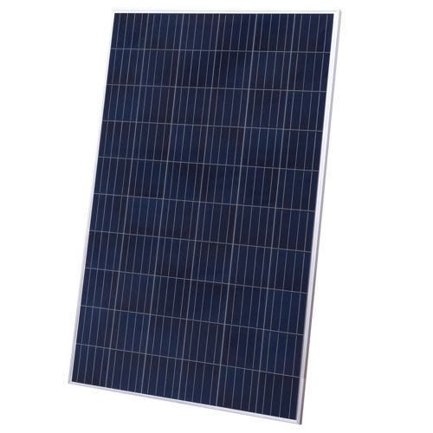
Amorphous substances as pseudo-solids or supercooled liquids:
Amorphous substances are usually termed as pseudo-solids or super cooled liquids because of the ability of amorphous solids like glass to flow.
Glass tends to become milky is appearance over a long period of time. This is because of slow crystallization of glass.
Amorphous silicon is used to make photovoltaic cells.

Slide 11
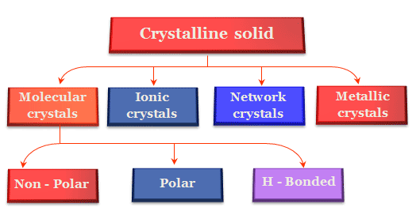

Slide 12
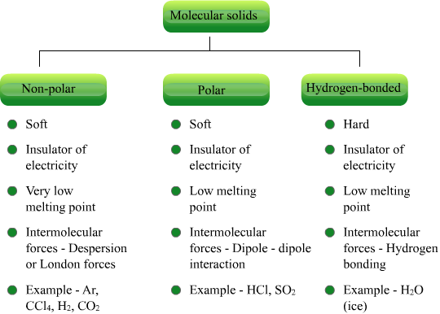

Slide 13
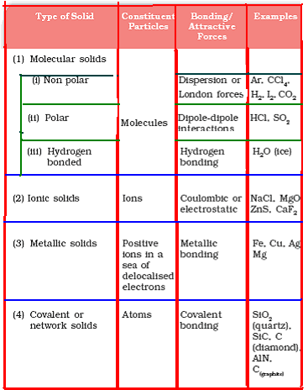

Slide 14
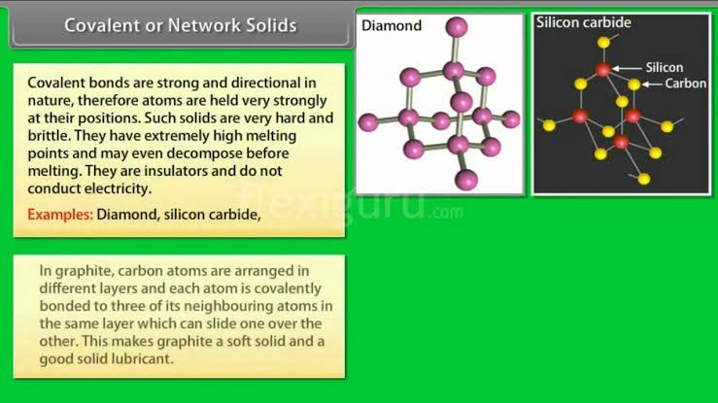

Slide 15
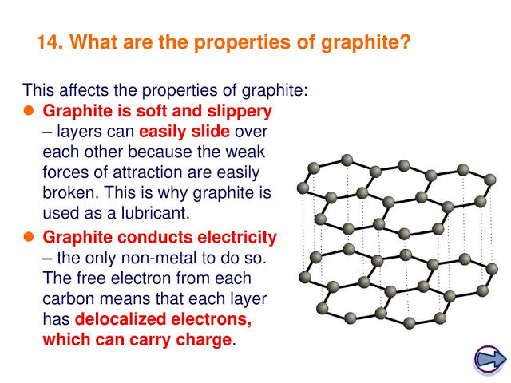

Slide 16
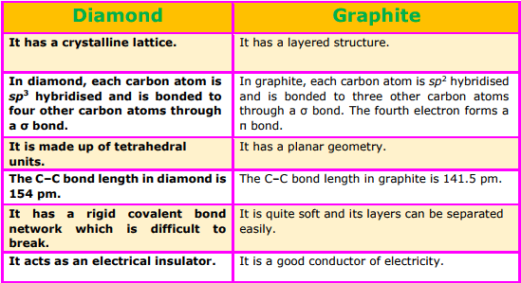

Slide 17
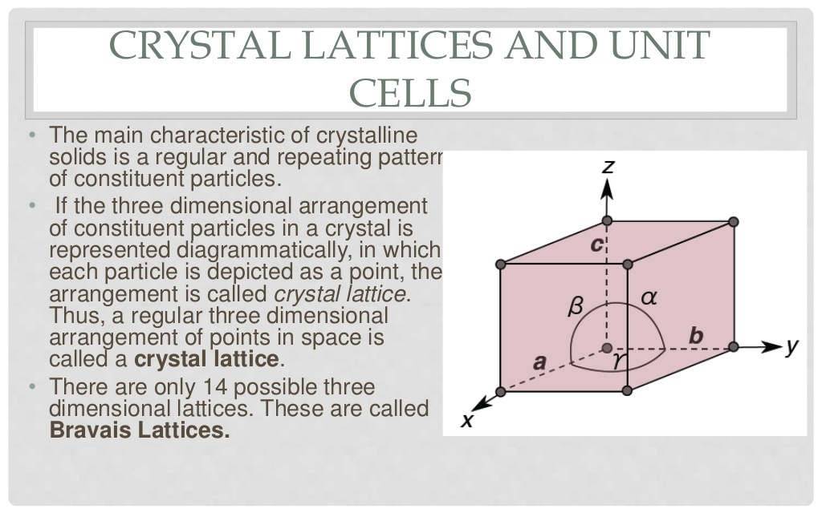

Slide 18
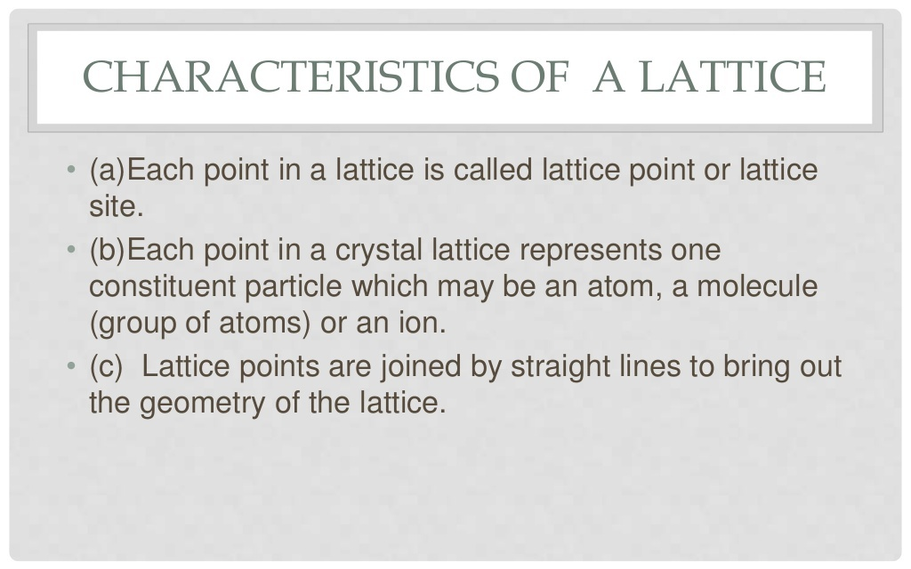

Slide 19
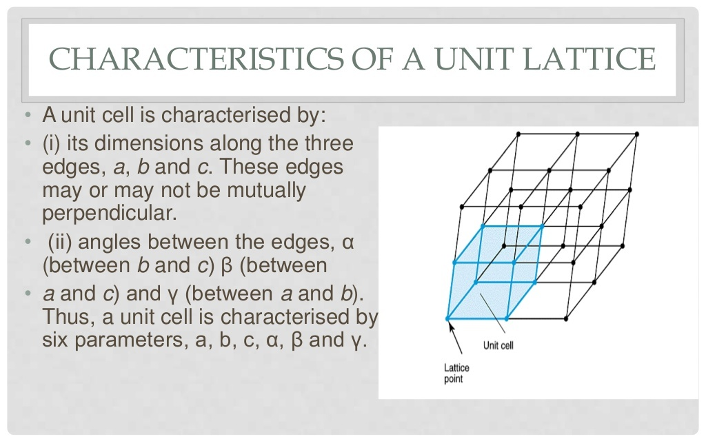

Slide 20
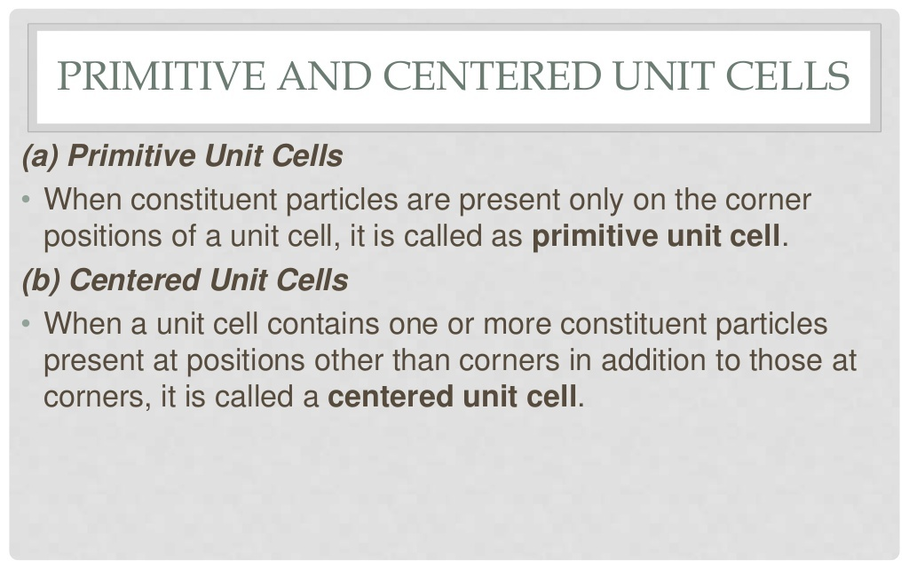

Slide 21
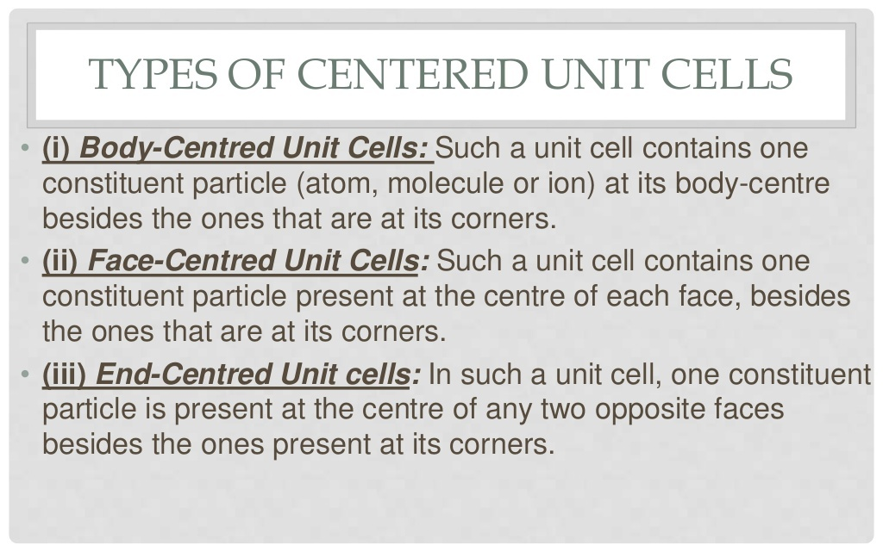

Slide 22
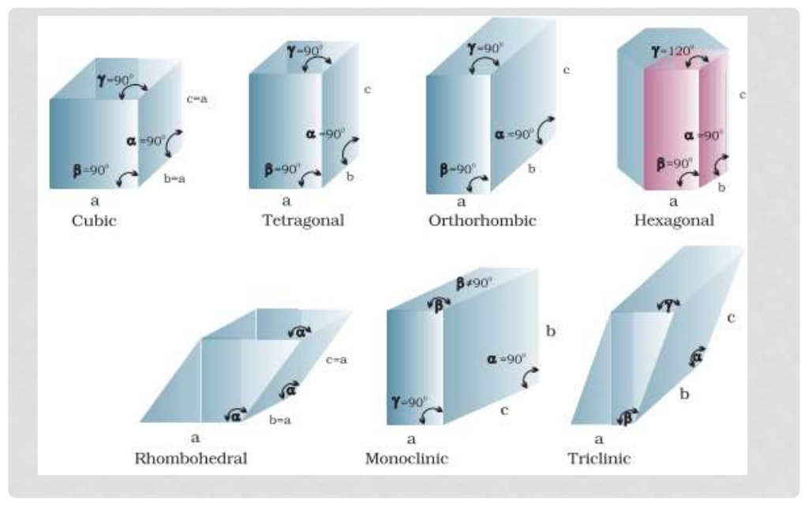

Slide 23
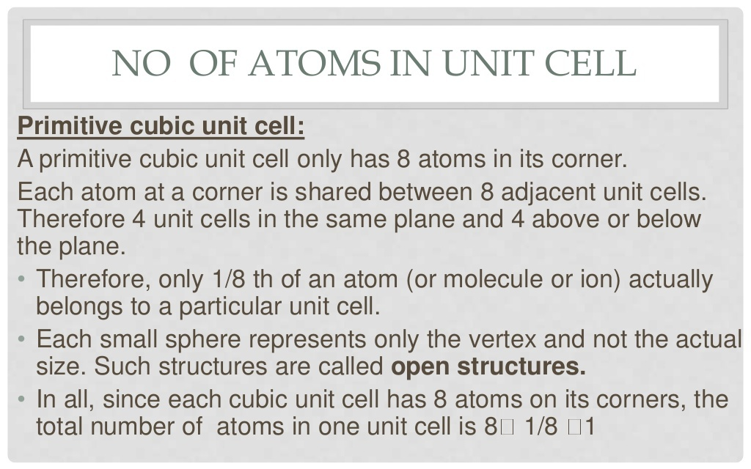

Slide 24
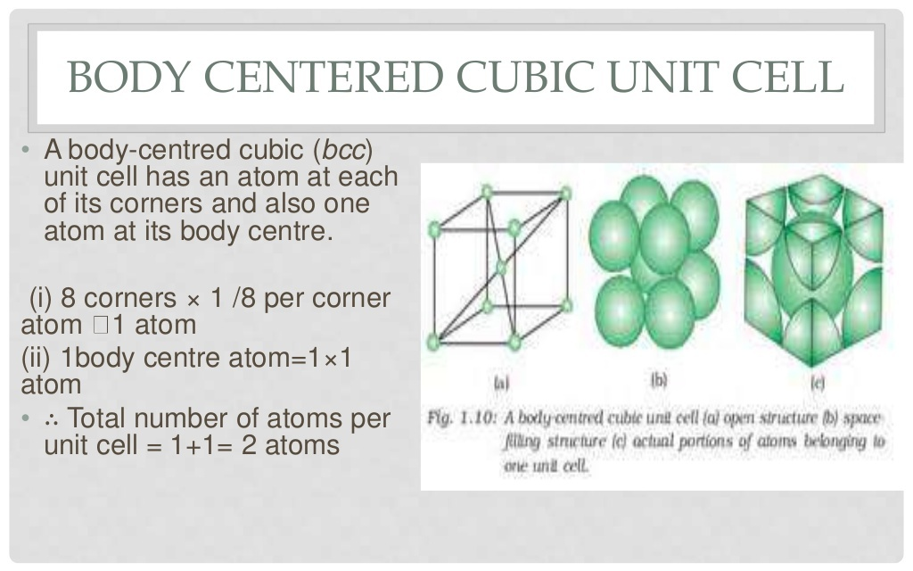

Slide 25
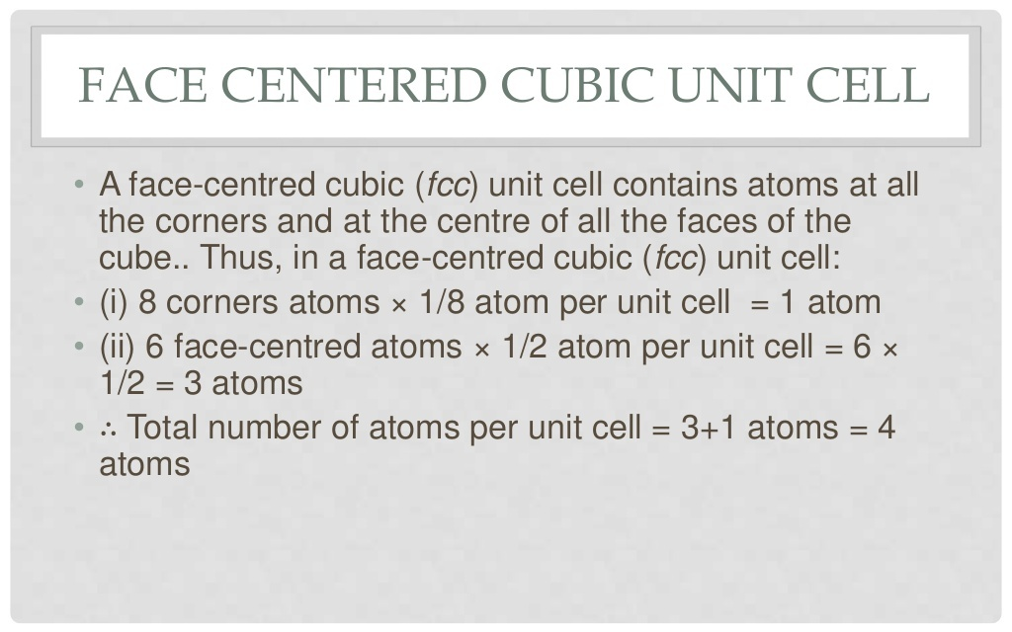

Slide 26
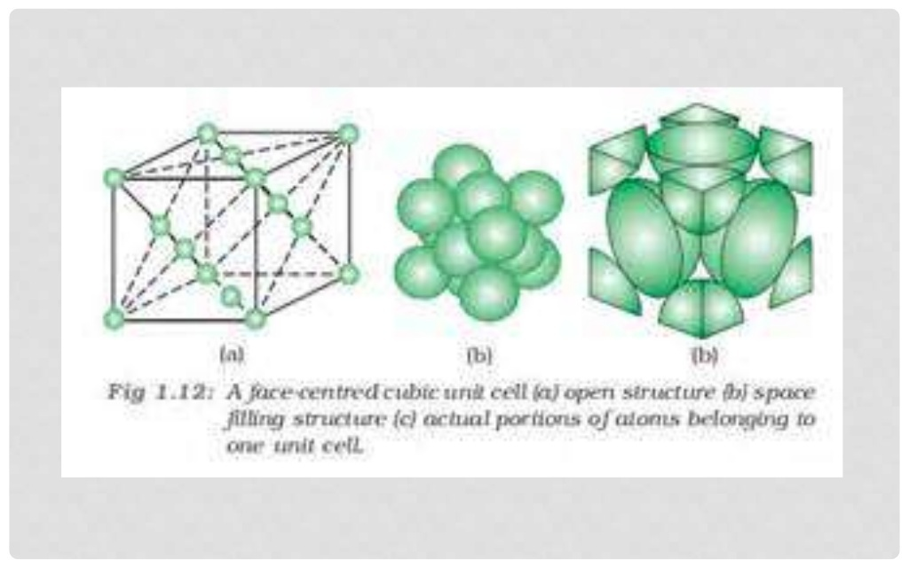

Slide 27
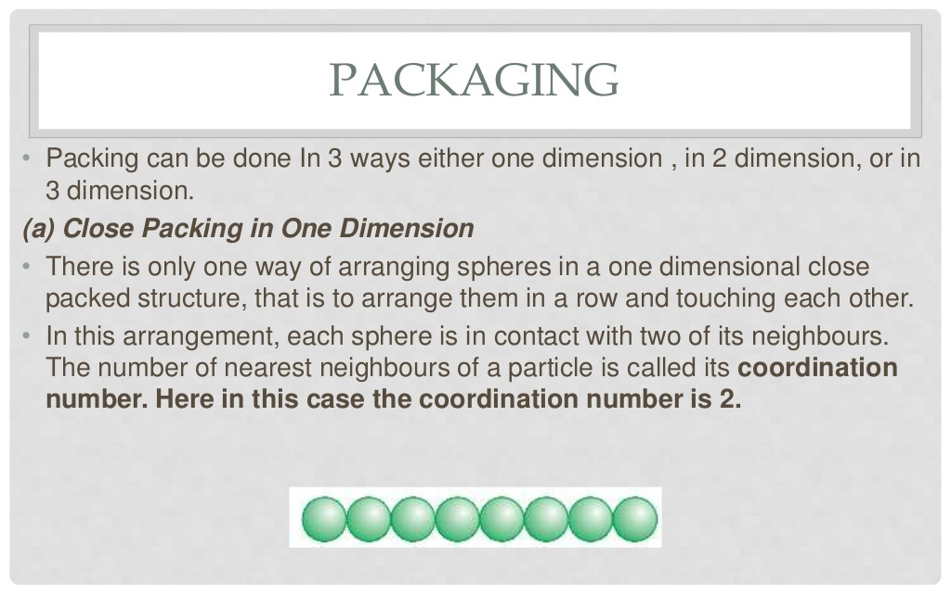

Slide 28
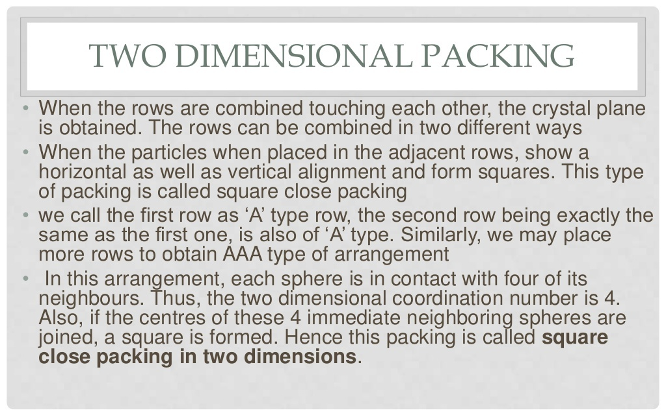

Slide 29
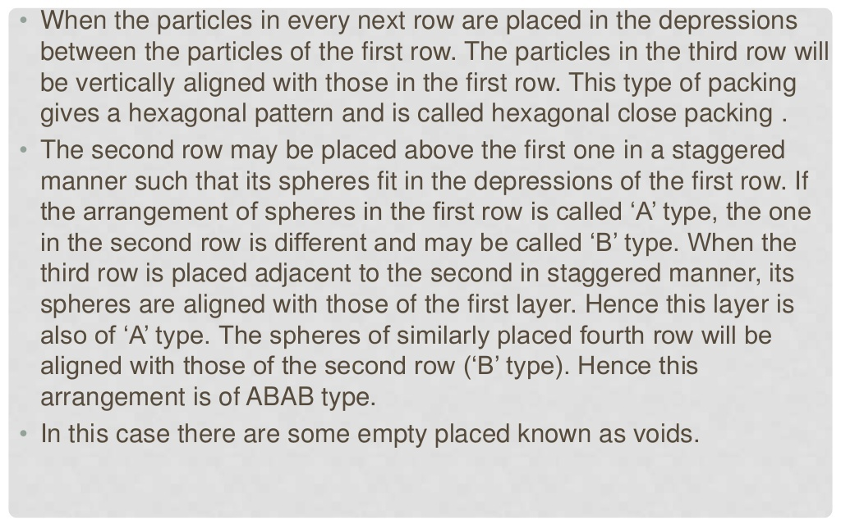

Slide 30
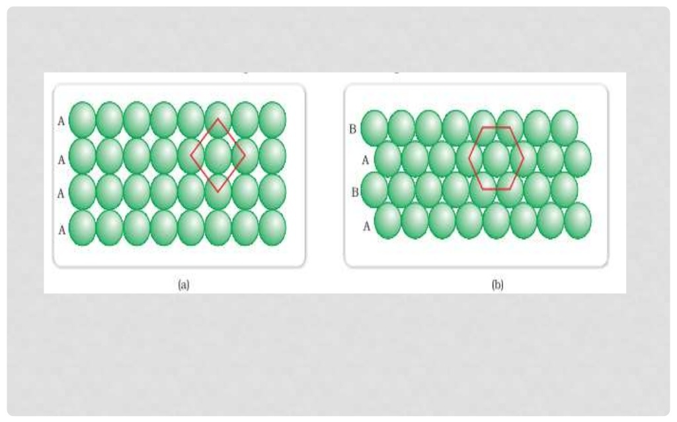

Slide 31
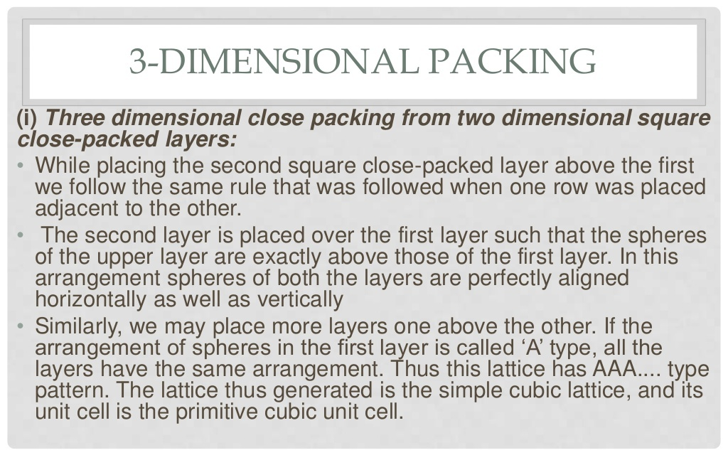

Slide 32
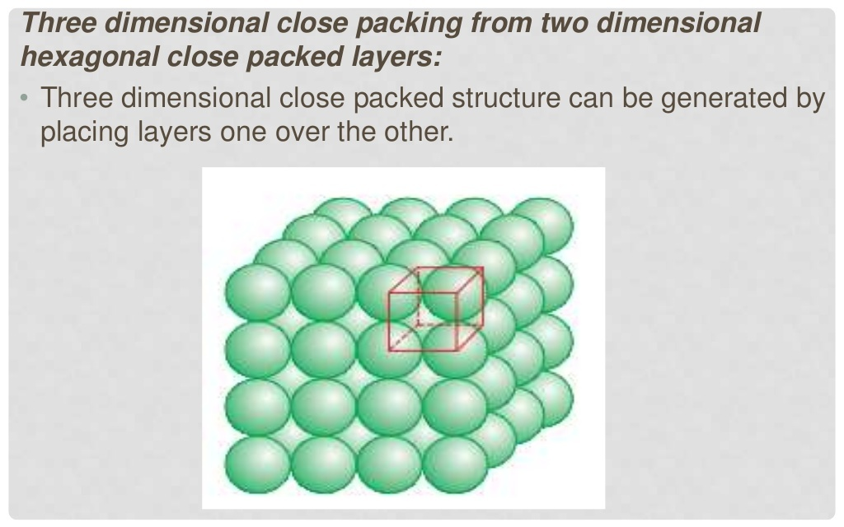

Slide 33
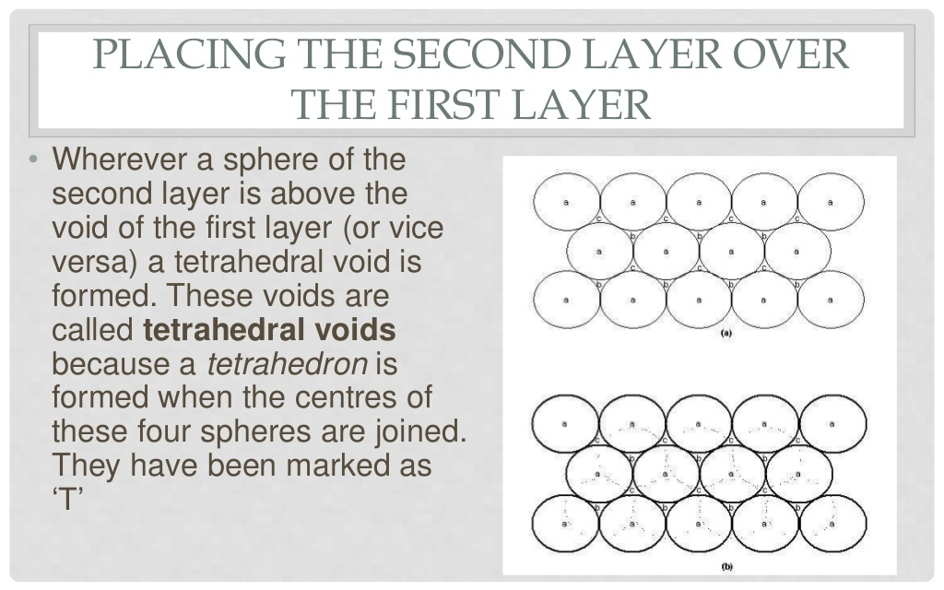

Slide 34
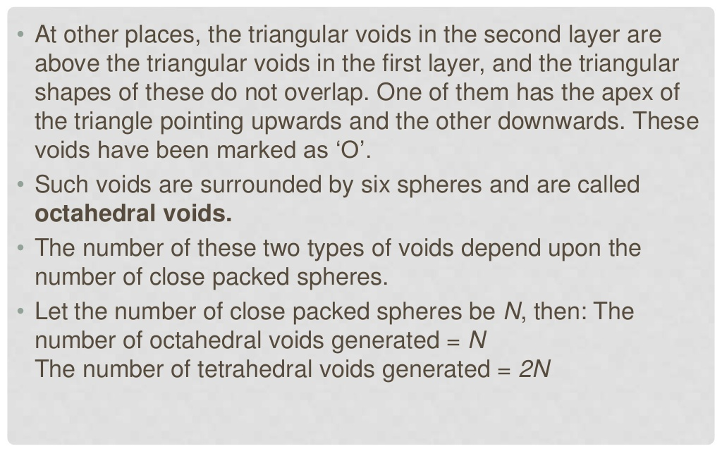

Slide 35
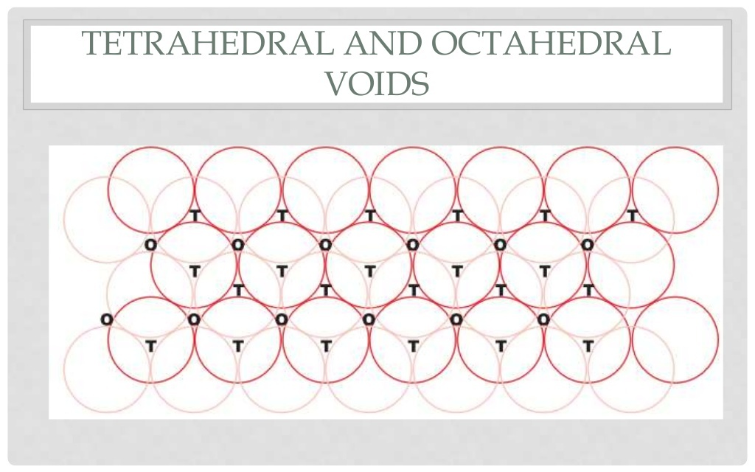

Slide 36
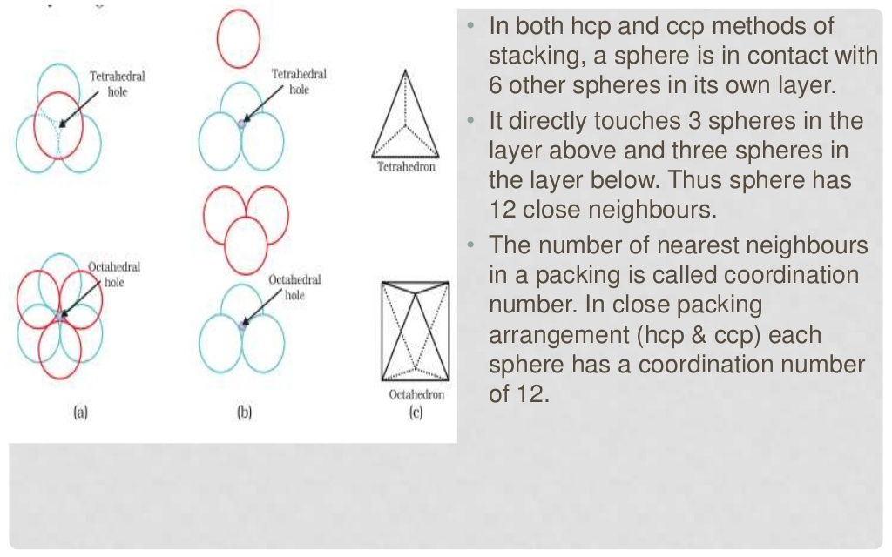

Slide 37
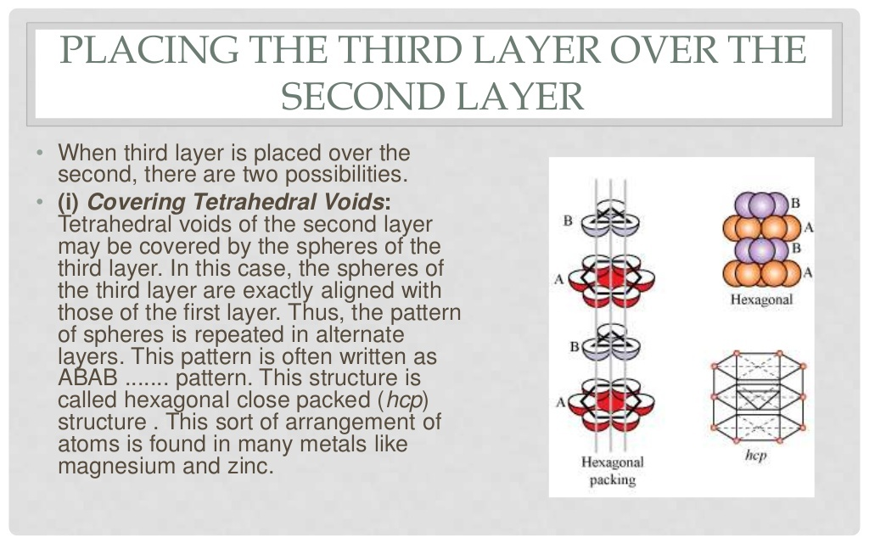

Slide 38
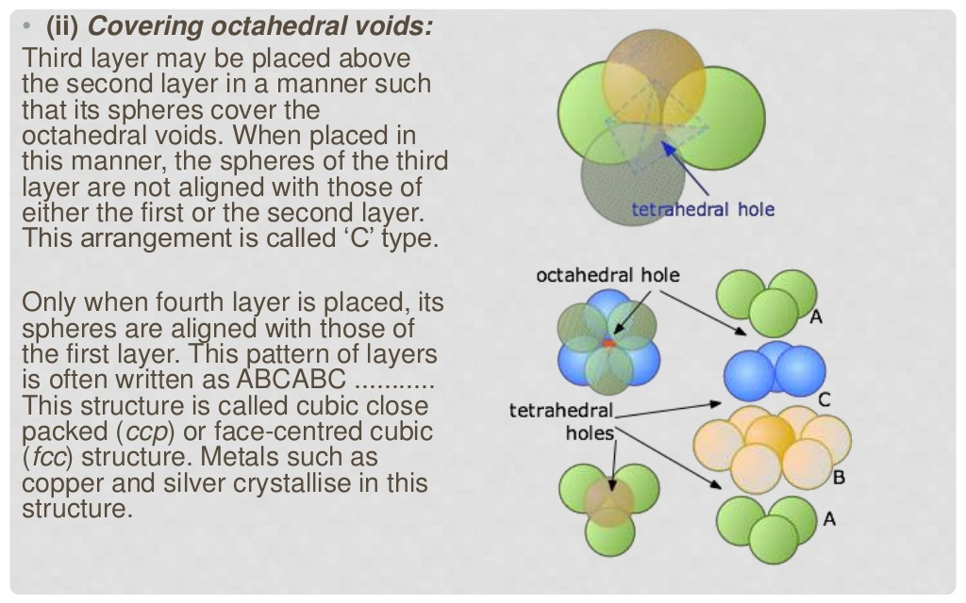

Slide 39
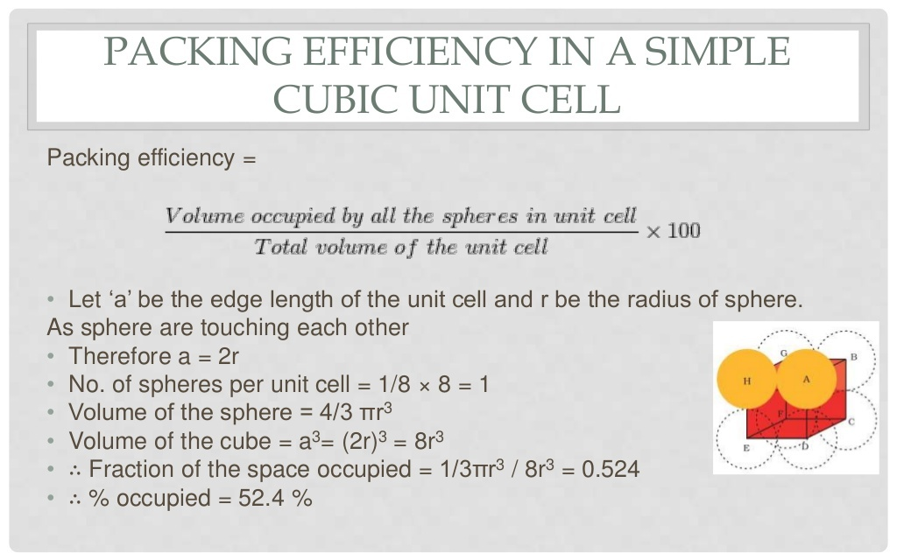

Slide 40
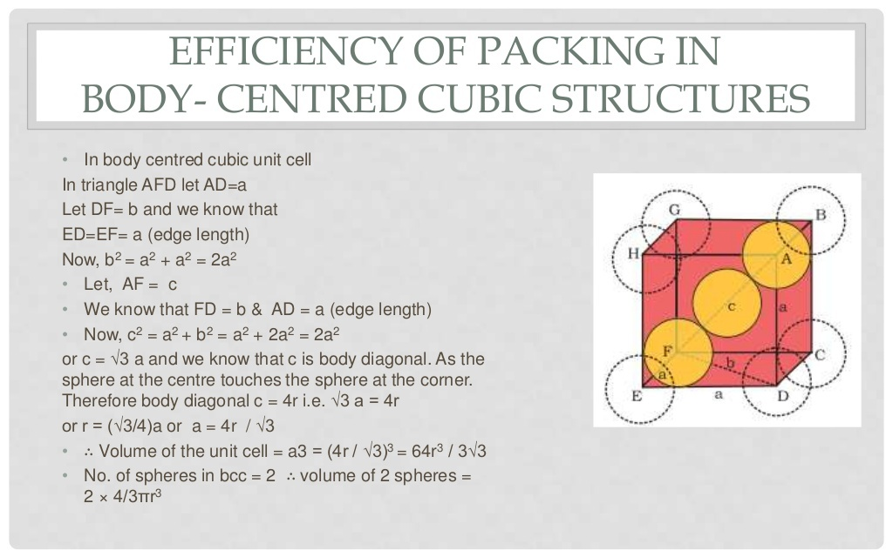

Slide 41
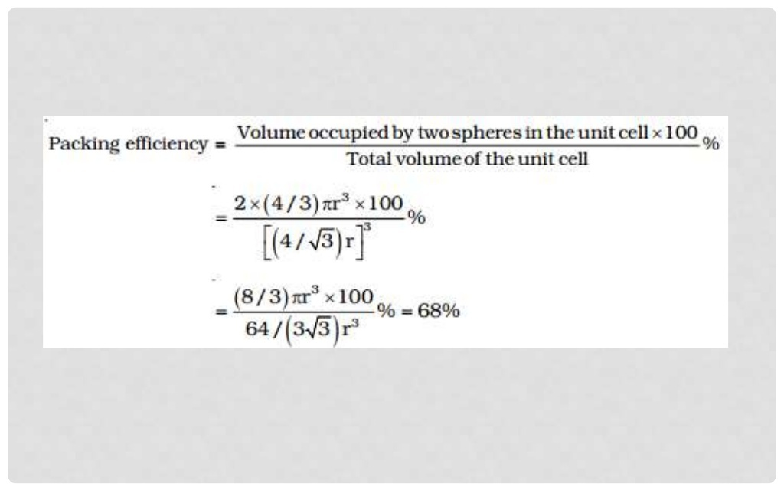

Slide 42
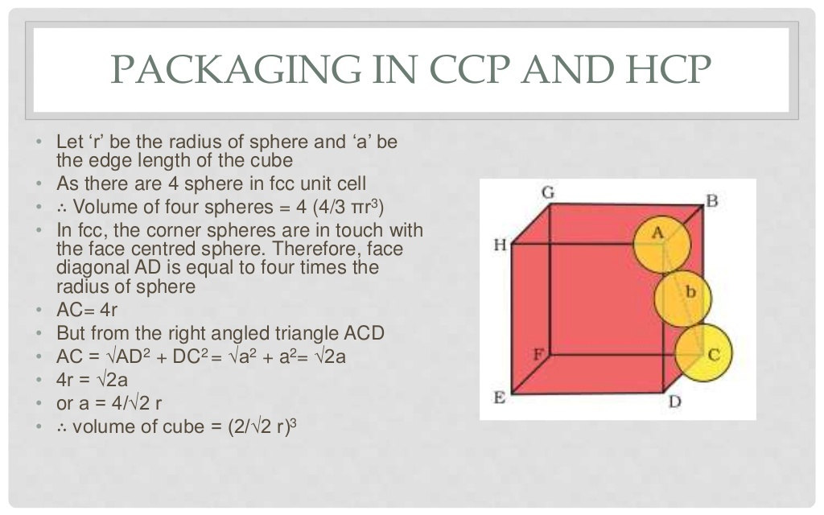

Slide 43
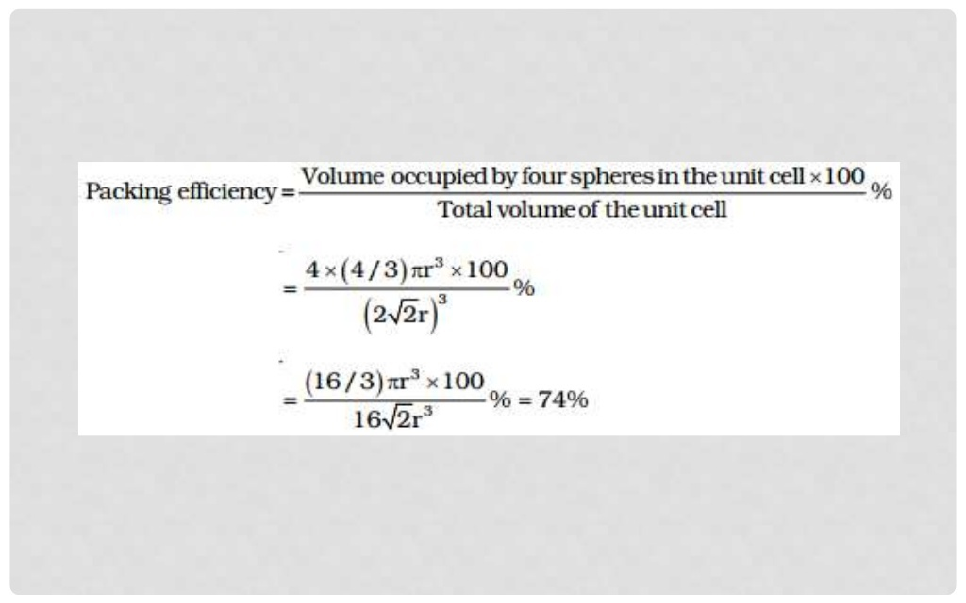

Slide 44
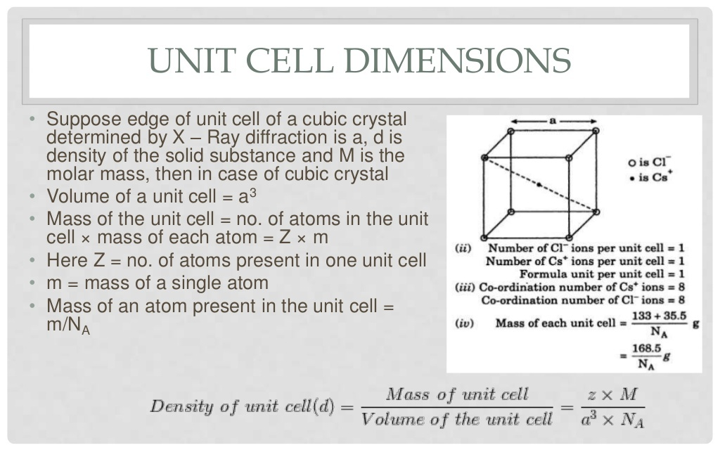

Slide 45
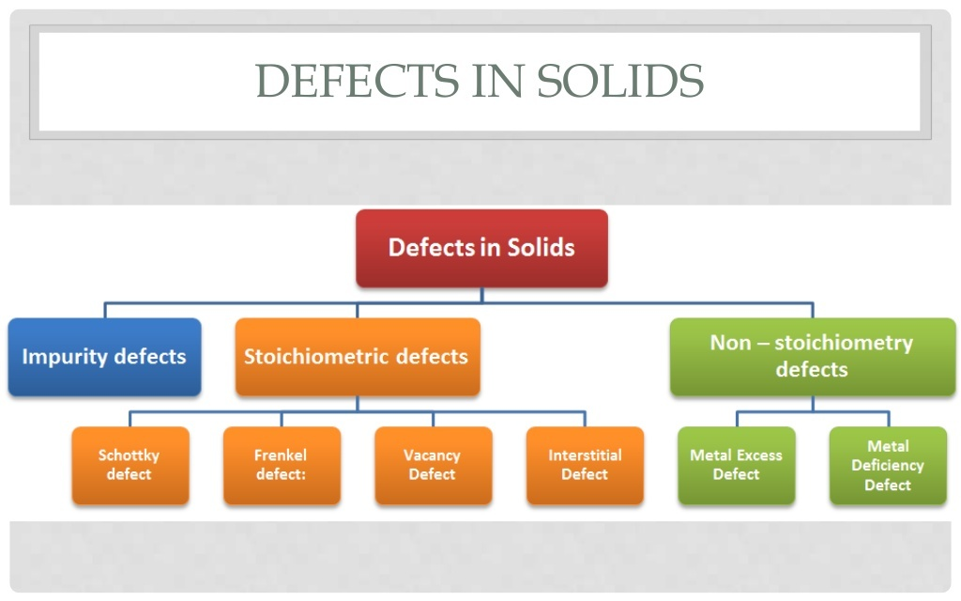

Slide 46
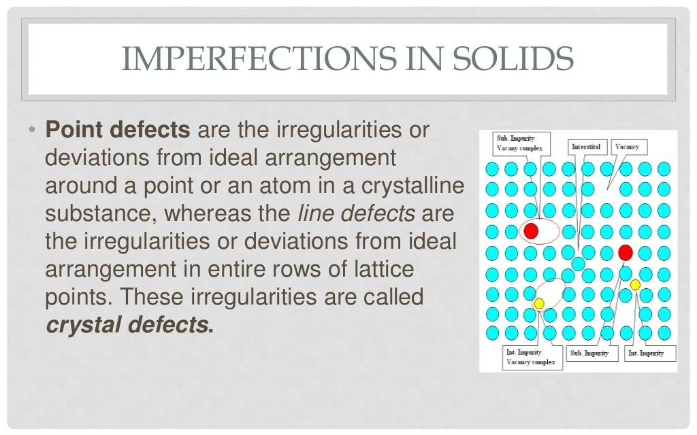

Slide 47
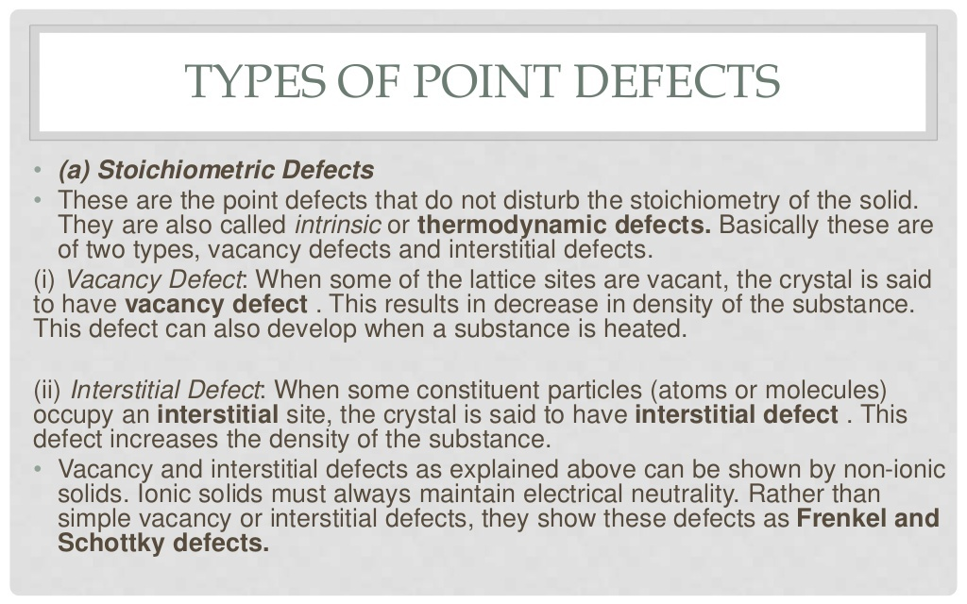

Slide 48
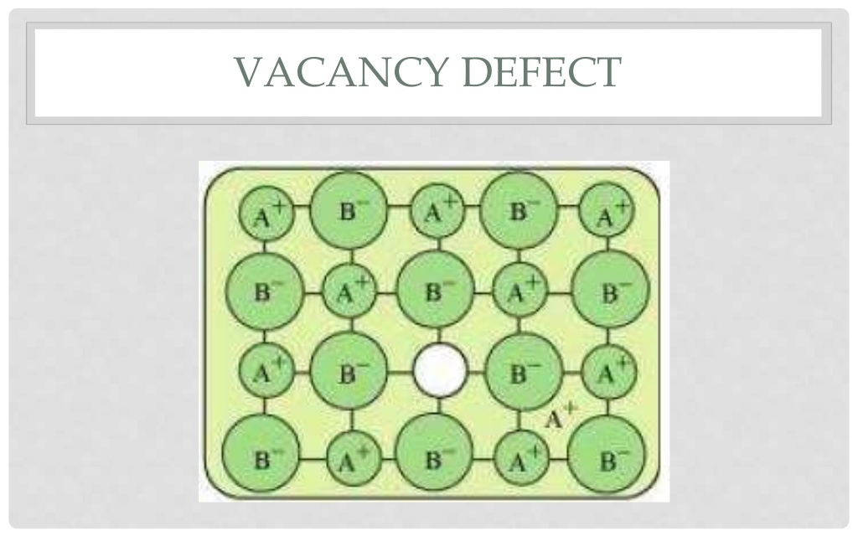

Slide 49
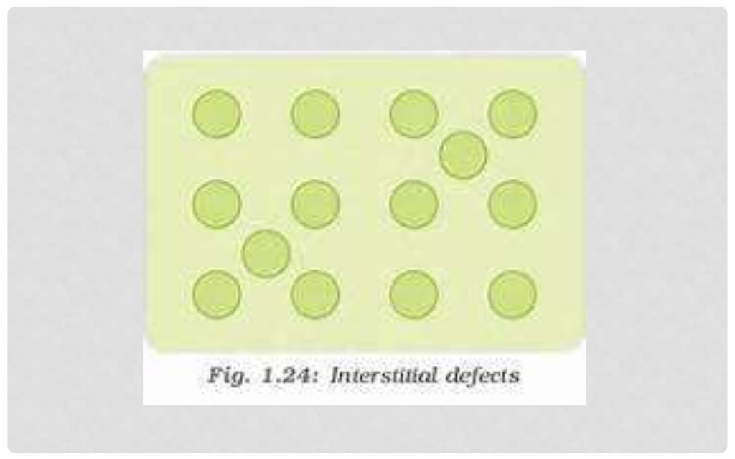

Slide 50
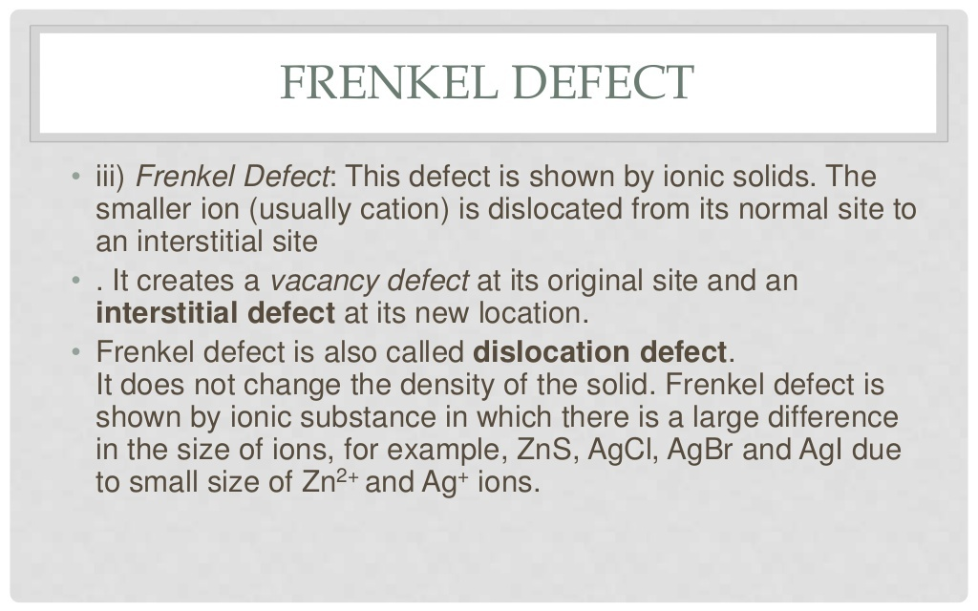

Slide 51
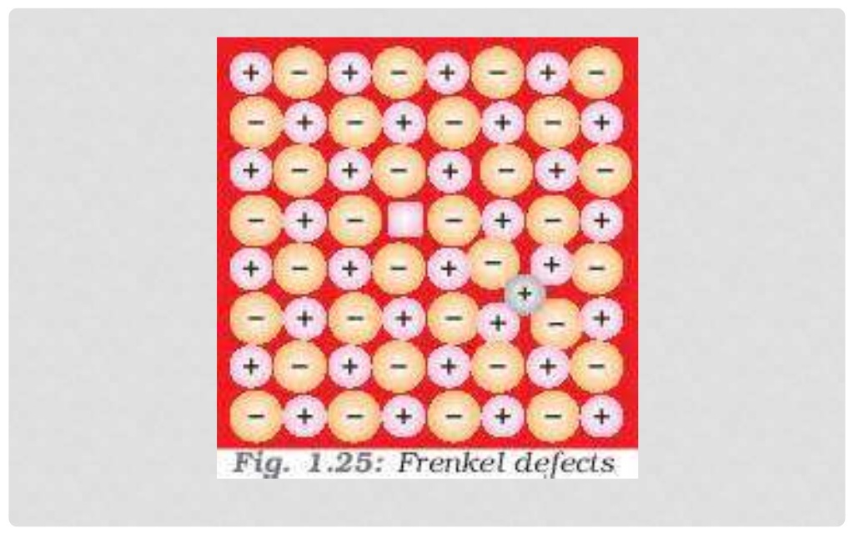

Slide 52
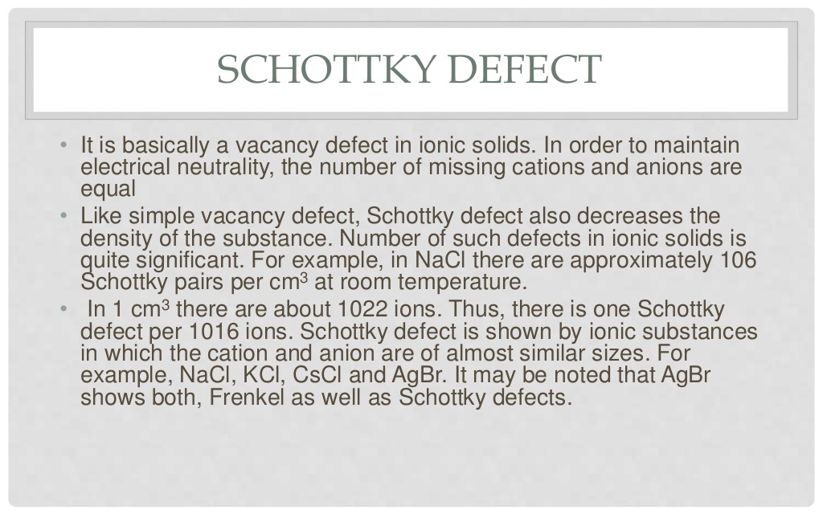

Slide 53


Slide 54


Slide 55


Slide 56


Slide 57


Slide 58


Slide 59


Slide 60


Slide 61


Slide 62


Slide 63


Slide 64


Slide 65


Slide 66


Slide 67


Slide 68


Slide 69


Slide 70


Slide 71


Slide 72


Slide 73


Slide 74


Slide 75


Slide 76


Slide 77


